Slide 1
AI Problem Design & Reinforcement Learning
AI Problem Design
Complexity in AI
Data Requirements
Solution Evaluation Metrics
Introduction to Reinforcement Learning

Slide 2
AI Problem Design
AI problem design means clearly defining:
What is the goal?
What are the inputs?
What should be the output?
What constraints exist?
Example:
Spam detection → Input: Emails → Output: Spam or Not Spam
Self-driving car → Input: Sensor data → Output: Steering decisions
👉 A well-defined problem makes AI solution easier and more accurate.

Slide 3
Problem Complexity
Complexity refers to how difficult a problem is to solve.
Types of Complexity:
Time Complexity – How long the algorithm takes.
Space Complexity – How much memory it uses.
Computational Complexity – How many calculations are required.
Example:
Sorting numbers → Simple
Playing chess → Very complex (millions of possibilities)
👉 Higher complexity requires better algorithms and more computing power.

Slide 4
Types of AI Problems Based on Complexity
Types of AI Problems
Simple Problems
Fixed rules
Limited data
Example: Calculator
Moderate Problems
Pattern recognition
Example: Image classification
Complex Problems
Dynamic environment
Multiple decisions
Example: Autonomous driving
👉 As complexity increases, traditional programming becomes difficult.

Slide 5
Data Requirements in AI
Data Requirements
AI systems learn from data.
Important factors:
Quantity – Large datasets improve learning.
Quality – Clean and accurate data is important.
Diversity – Data should represent real-world variations.
Labeling – Required in supervised learning.
Example:
Face recognition needs thousands of face images.
Chatbots need large text datasets.
👉 Poor data = Poor AI performance.

Slide 6
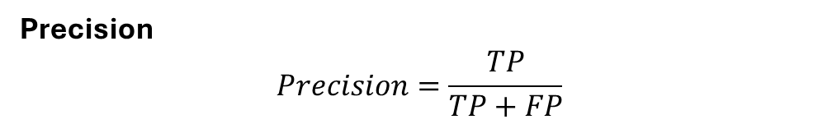
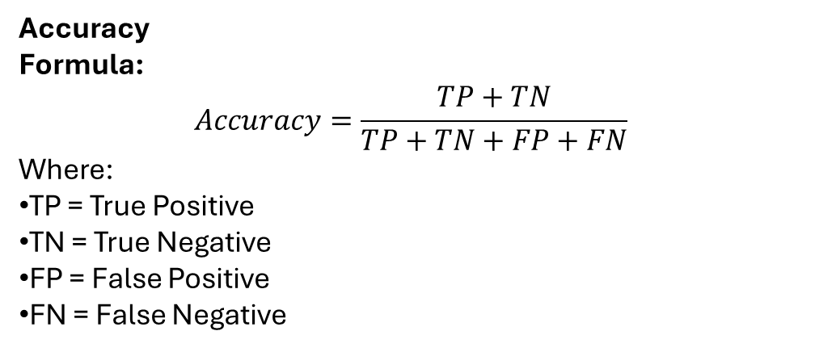

Solution Metrics (How to Measure AI Performance)
Solution Evaluation Metrics
To check if AI model works properly, we use metrics.
For Classification:
Accuracy
Precision
Recall
F1-Score
For Regression:
Mean Absolute Error (MAE)
Mean Squared Error (MSE)
For Reinforcement Learning:
Total Reward
Average Reward
👉 Metrics help compare models and improve performance.
Accuracy
Formula:
$$Accuracy=\frac{TP+TN}{TP+TN+FP+FN}$$
Where:
TP = True Positive
TN = True Negative
FP = False Positive
FN = False Negative
Precision
$$Precision=\frac{TP}{TP+FP}$$
Recall
$$Recall=\frac{TP}{TP+FN}$$

Slide 7
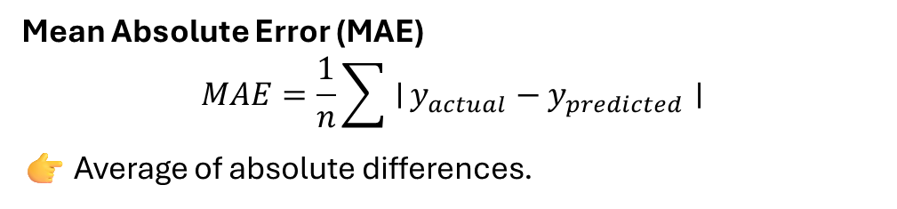

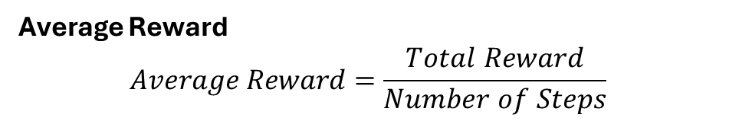
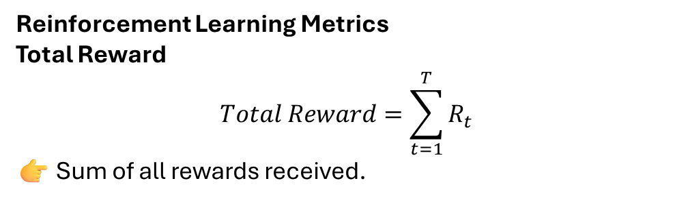

Reinforcement Learning Metrics
Total Reward
$$Total Reward=\sum_{t=1}^{T}{R_{t}}$$
👉 Sum of all rewards received.
F1-Score
$$F1=2×\frac{Precision×Recall}{Precision+Recall}$$
👉 Harmonic mean of Precision and Recall.
Mean Absolute Error (MAE)
$$MAE=\frac{1}{n}\sum{∣}y_{actual}−y_{predicted}∣$$
👉 Average of absolute differences.
Average Reward
$$Average Reward=\frac{Total Reward}{Number of Steps}$$
Mean Squared Error (MSE)
$$MSE=\frac{1}{n}\sum{(}\left.y_{actual}−y_{predicted}{\left.)\right.}^{2}\right.$$
👉 Average of squared differences.

Slide 9
Introduction to Reinforcement Learning (RL)
Reinforcement Learning
Reinforcement Learning is a type of machine learning where:
An agent learns by interacting with environment.
It takes actions.
Receives rewards or penalties.
Learns to maximize total reward.
👉 Learning by trial and error.

Slide 10
Components of Reinforcement Learning
Main Components of RL
Agent – The learner (robot, AI model)
Environment – Where agent acts
State – Current situation
Action – Decision taken
Reward – Feedback received
Example:
Game playing AI
Agent: Game player
Action: Move
Reward: Win or lose points
Reinforcement Learning in Sequential Decision Problems
Sequential Decision Problems
In RL:
Decisions are made step by step.
Current action affects future results.
Goal: Maximize long-term reward.
Examples:
Self-driving cars
Robotics
Stock trading
Game playing (Chess, Go)
👉 RL is powerful for dynamic and real-time decision-making problems.

